Slide 1

A Christ-Centered SEL & Leadership Formation Program
Bishop Diego High School • Grades 9-12

Slide 2
JUNIOR • GRADE 11
9 Temperaments
Explains the nine dimensions of temperament as the "how" of personality—our natural way of reacting to environmental stimuli. Students identify their unique temperament profile to better understand their internal reactions.
CASEL FOCUS
Self-Awareness & Responsible Decision-Making
CST LENS
Subsidiarity

Slide 3

9 Temperaments: The "How" of Personality
Understanding How We React to Environmental Stimuli

Slide 4

Creating a Goodness-of-Fit Environment
Optimal development occurs when environment matches individual temperament
Good Fit Results
Harmony between person and environment
Reduced stress and conflict
Enhanced development and well-being
Poor Fit Results
Stress, anxiety, and conflict
Maladaptive functioning
Behavioral problems
Work WITH temperament, not against it

Slide 5
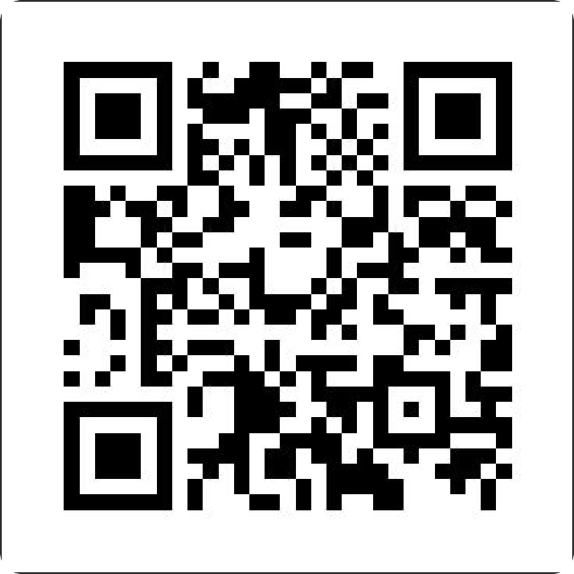
Discover Your Temperament
Scan to take the assessment
9Temperaments.abacusai.app
Discover your unique temperament profile
Takes just 10 minutes

Slide 6

Activity Level
High Activity Level
Physically energetic
Constantly in motion
Hard to sit still
Strengths: Excel in sports and high-energy careers Challenge: May seem restless or disruptive
Low Activity Level
Calmer presence
Prefer sedentary pursuits
Move slowly and deliberately
Strengths: Focus on quiet tasks thoughtfully Challenge: May be mislabeled as lazy

Slide 7

Quality of Mood
Positive Mood
Generally cheerful
Pleasant and optimistic
Laugh easily
Strengths: Natural optimism uplifts others Challenge: May minimize real problems
Serious Mood
More analytical
Subdued disposition
Focus on potential problems
Strengths: Careful analysis and problem-solving Challenge: May be perceived as gloomy

Slide 8

Rhythmicity (Regularity)
High Rhythmicity (Regular)
Predictable biological patterns
Consistent sleep and hunger
Clock-like cycles
Strengths: Thrive with structured routines Challenge: Difficulty with disruptions
Low Rhythmicity (Irregular)
Unpredictable schedules
Variable hunger patterns
Flexible energy cycles
Strengths: Adaptable to unconventional hours Challenge: Hard to establish routines

Slide 9

Distractibility
High Distractibility
Highly aware of surroundings
Easily sidetracked
Notice environmental details
Strengths: High perceptiveness, easily redirected Challenge: Focus challenges during tasks
Low Distractibility
Tune out environment
Concentrate intensely
Work amidst interruptions
Strengths: Clear focus and productivity
Challenge: May miss important external cues

Slide 10

Intensity of Reaction
High Intensity
React with great force
Express joy with shouts
Frustration dramatically
Strengths: Passionate, needs clearly noticed
Challenge: Can be labeled dramatic
Low Intensity (Mild)
Subdued emotional reactions
Whimper when hungry
Steady emotional presence
Strengths: Calm, easygoing presence
Challenge: Feelings easily overlooked

Slide 11
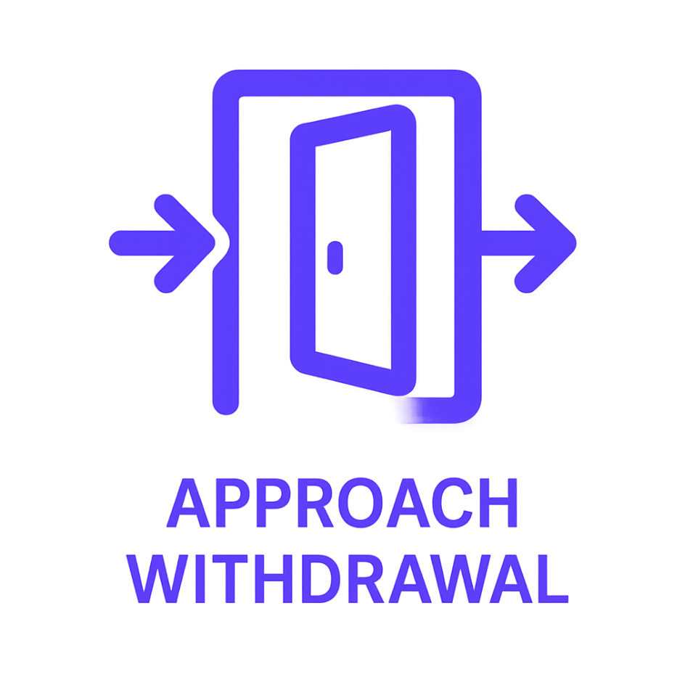
Approach/Withdrawal
Initial Reaction to New Situations
High Approach
Eager with novelty
Jump into social situations
Curious about new experiences
Strengths: Sociable, adventurous spirit
Challenge: Potential impulsivity
Low Approach (Withdrawal)
Slow-to-warm-up
Hesitant with unfamiliar
Observe from sidelines first
Strengths: Cautious, think before acting
Challenge: Can be perceived as shy

Slide 12

Sensory Threshold
Sensitivity to Stimuli
Low Threshold (High Sensitivity)
React to low stimulation
Tags feel itchy
Dim lights seem bright
Strengths: Associated with creativity and empathy Challenge: Can seem picky, easily overwhelmed
High Threshold (Low Sensitivity)
Require great stimulation
Don't complain about injuries
Sleep through noise
Strengths: Resilience and toughness Challenge: May not recognize illness signs

Slide 13

Persistence & Attention Span
High Persistence
Stick with problems
Try different strategies
Long attention span
Strengths: Tenacity leads to achievement Challenge: Difficult to redirect
Low Persistence
Give up when difficult
Ask for help immediately
Move on quickly
Strengths: Develop social skills, use resources Challenge: May not complete challenging tasks

Slide 14

Adaptability
High Adaptability
Flexible, go with flow
Smooth transitions
Embrace change easily
Strengths: Easy to work with, resilient Challenge: Own needs may be overlooked
Low Adaptability
Find transitions difficult
Resistant to changes
Thrive on predictability
Strengths: Less swayed by negative influences Challenge: Unexpected changes cause distress

Slide 15
Personality Constellations
How Temperament Dimensions Combine
The Easy Child
40%
Generally positive mood
Regular patterns
Adaptable to change
The Spirited Child
10%
Intense reactions
Irregular patterns
Initial withdrawal
The Cautious Child
15%
Initial withdrawal
Low intensity
Need time to adjust
The Mixed Group
35%
Unique combinations
Don't fit single pattern
Individual complexity

Slide 16
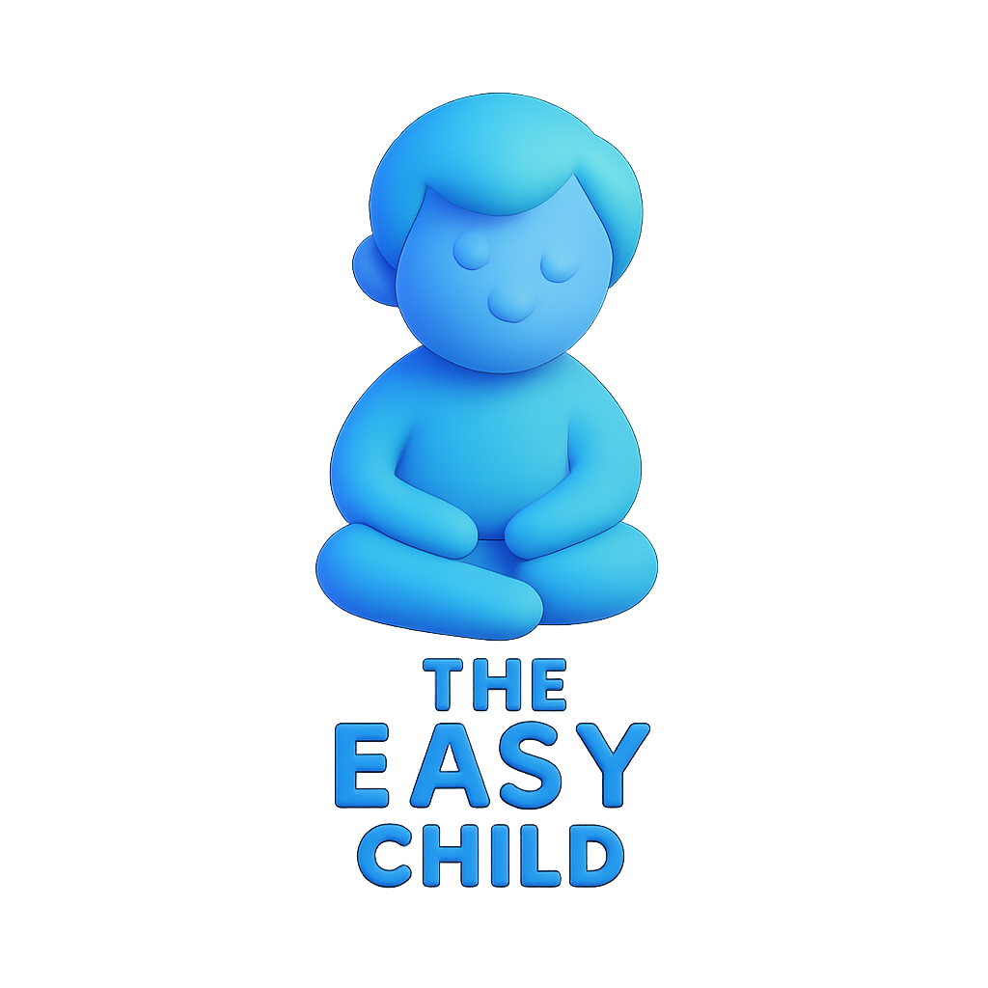
The Easy Child (40%)
Flexible Child • Adaptable Child
Key Profile
Generally positive mood
Regular biological functions
Adaptable to change
Mild to moderate reactions
Characteristics
Establish routines easily
Adapt well to new experiences
Generally cheerful disposition
Important Note: Don't assume no difficulties Support Strategy: Check in proactively

Slide 17

The Spirited Child (10%)
Difficult Child • Feisty Child
Key Profile
Intense reactions
Irregular biological patterns
Initial withdrawal from new
Characteristics
Unpredictable schedules
Cries frequently & intensely
Frustrated by disrupted routines
Support Strategies
Create predictable routines
Provide constructive energy outlets
Offer safe high-energy play

Slide 18

The Cautious Child (15%)
Slow-to-Warm-Up • Shy Child
Key Profile
Initial withdrawal from novelty
Low-intensity reactions
Needs time to adjust
Characteristics
Quiet and relatively inactive
Appears shy in new situations
Needs gentle exposure to adjust
Support Strategies
Use patience and preparation
Provide advance warnings
Allow safe observation distance

Slide 19

The Mixed Group (35%)
Individual Complexity
Key Point
Over one-third don't fit single constellation
Characteristics
Unique combinations from different profiles
Validate temperament exists on spectrum
Not rigid categories
Implications
Individual assessment needed
Avoid forcing into single category
Recognize complexity and uniqueness

Slide 20
Let's Apply It!
Discussion & Reflection
Think about someone you know well...
Consider their temperament profile across the 9 dimensions.
For Parents & Caregivers
Apply "goodness of fit" from the start
Adapt the environment to the child's style
Shift from being a manager to a consultant
For Individuals
Develop self-awareness of your profile
Choose fitting careers and relationships
Create environments that support you
Universal Benefits
Move from conflict to understanding
Appreciate a diversity of styles
Build empathy through awareness
Work with, not against, natural tendencies.

